Slide 1
Challenge II - The Smart Energy Bill
Good morning
Ankara!!!

Slide 2


Challenge II - The Smart Energy Bill

Slide 3

Open (Data) means
Open licenses
every one can use, re-use and redistribute the data
Open, machine-readable formats (i.e. csv)
No discrimination
without login or other barriers to access
Pro-active & timely

Slide 4

Why Open Data?
Making decision transparent and accountable.
Understanding complex issues.
Foster innovation.

Slide 5

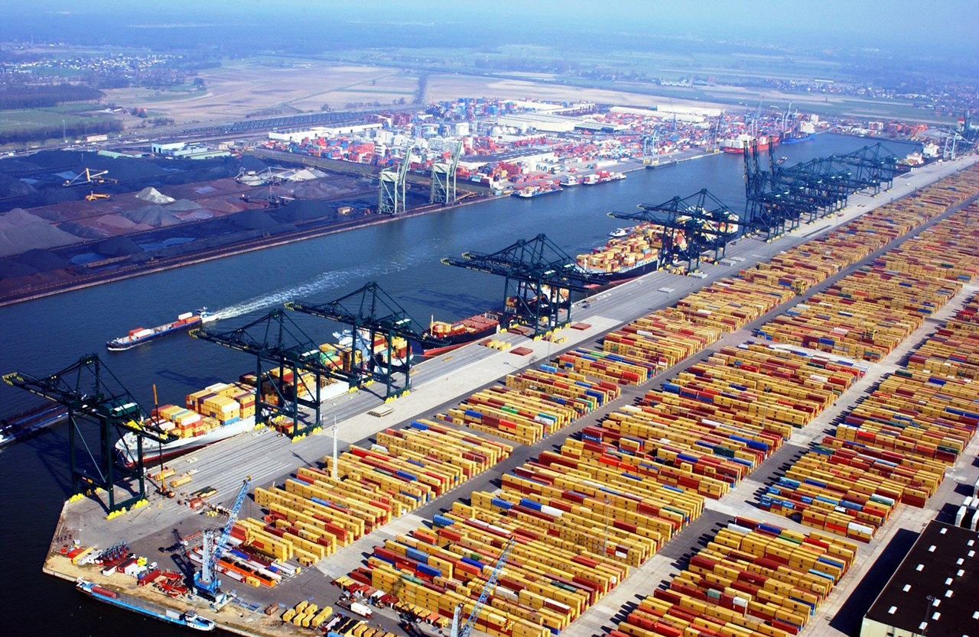

Open Data enables
to automatic roll-out
with open data & open standards
from manual data work

Slide 6
Challenge II - The Smart Energy Bill
How can we help private households comparing their heating
and electricity bills? Can we gamify this approach in local
neighbourhoods or develop a new web platform for the
comparison of electricity suppliers

Slide 7
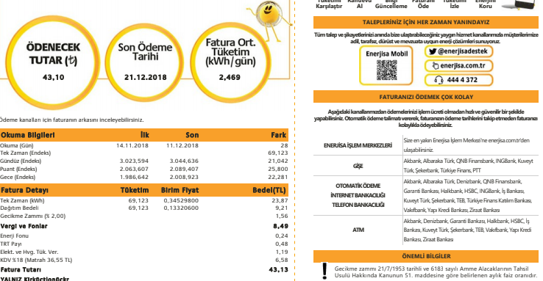
Challenge II - The Smart Energy Bill

Slide 8
Challenge II - The Smart Energy Bill
Lower costs
Lower energy consumption

Slide 9
Challenge II - The Smart Energy Bill
This can be
app
prototype
idea
incentive systems
whatever you can think about

Slide 10
Challenge II - The Smart Energy Bill
Think about
Natural Persons: Tenant, subtenant, commercial tenant
persons living or working in an object.
Providers in the areas of real estate services, heat,
power, gas, metering, smart home, e-mobility
Legal Persons: property owners, managers, property owner representatives, asset managers, property managers.
Legislative approach / policy

Slide 11
Challenge II - The Smart Energy Bill
If you need data sets (https://pad.okfn.de/p/eehackankara)
or just ask me to help find them have any other question.
Happy hacking!

